Slide 1
MPEG-1 Implementation
By Hsiao Po-Kang
Communication & Multimedia Laboratory
Department of Computer Science and Information Engineering, National Taiwan University

Slide 2

Symbols and Abbreviations
Arithmetic Operators
  / Integer division with truncation of the result toward zero.
    7/4=1, -7/-4=1, -7/4=-1, 7/-4=1
  // Integer division with rounding to the nearest integer
    3//2=2, -3//2=-2
  DIV Integer division with truncation of the result toward
    3 DIV 2=1, -3 DIV 2=-2

Slide 3
Syntax
MPEG-1’s syntax is described as a C-code style. You can simply copy and paste and add you codes on it.
Syntax Hierarchy
  Sequence Layer: video_sequence()
  GOP Layer: group_of_picture()
  Picture Layer: picture()
  Slice Layer: slice()
  Macroblock Layer: macroblock()
  Block Layer: block()

Slide 4
Variable Length Codes
Tables:
  macroblock_address_increment
  macroblock_type
  coded_block_pattern
  motion_vectors
  Luminance/Chrominance DC/AC coefficients
Run-Length Coding:
  JPEG AC (Run-Size) followed by “Size”-bit AC coef.
  MPEG AC (Run-Level) followed by 1 sign bit.
When AC coefficient is out of AC run-level range, a fixed escape code is used. (6bit-run + 8 or 16 bit-level)

Slide 5
Macroblock Type
macroblock_quant
  quantizer_scale
macroblock_motion_forward
macroblcok_motion_backward
macroblock_pattern
  coded_block_pattern (CBP)
macroblock_intra

Slide 6
Macroblock Type Constraints
Intra v.s. Non-Intra?
Intra
  Non-Motion, Non-CBP
Non-Intra
  Motion & CBP
    Compensation with motion (x,y) …
  Motion & Non-CBP
    Direct Compensation with motion (x,y) …
  Non-Motion & CBP (in P-frame)
    Compensation with zero motion (0,0)
  ….

Slide 7
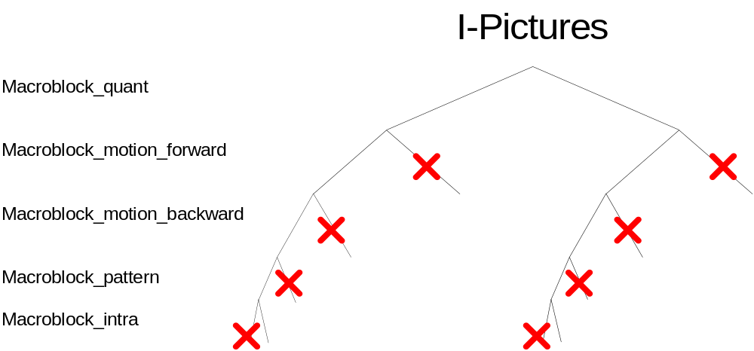
Macroblock Type in I-pictures
2 modes

Slide 8
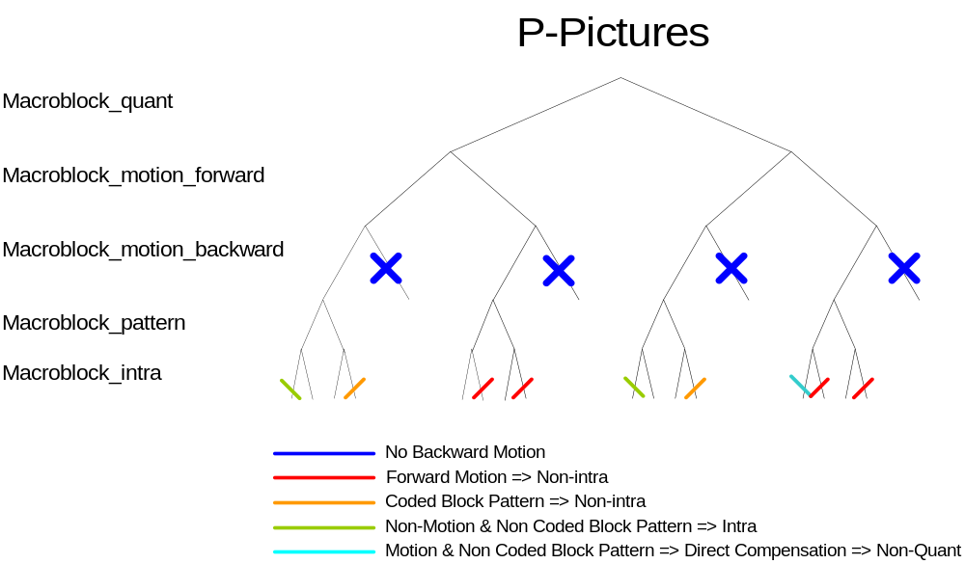
Macroblock Type in P-pictures
7 modes

Slide 9
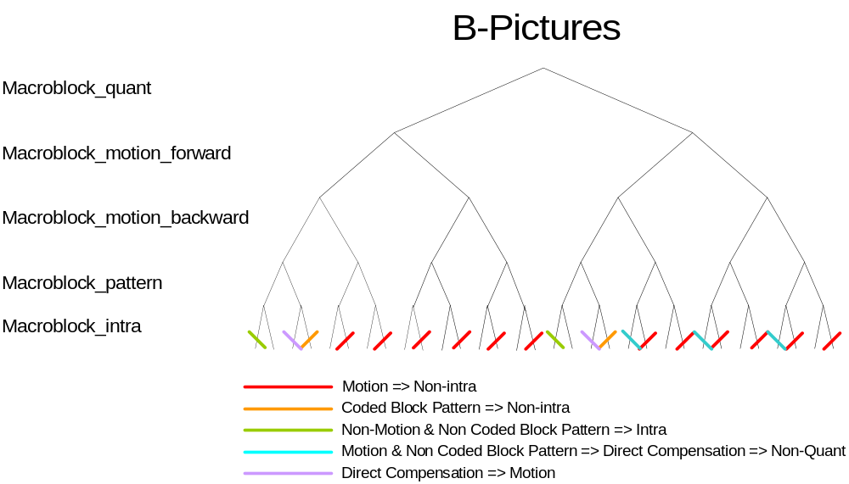
Macroblock Type in B-pictures
11 modes

Slide 10
Macroblock Skip
In I-pictures, all macroblocks are coded and there are no skipped macroblocks
In P-pictures, the skipped macroblock is defined to be a macroblock with a reconstructed motion vector equal to zero and no DCT coefficients.
In B-pictures, the skipped macroblock is defined to have the same macroblock type as the prior macroblock, differential motion vectors equal to zero (use the motion vector predictor as its motion vector), and no DCT coefficients.

Slide 11
Motion Vector Range
Range of motion_horizontal_forward_code: -16~16
forward_f_code | forward_r_size and range of motion_h orizontal_forward_r | forward_f | Motion Vector Range
 |  |  | full_pel=0 | full_pel=1
1 | 0 (0) | 1 | -8 to 7.5 | -16 to 15
2 | 1 (0~1) | 2 | -16 to 15.5 | -32 to 31
3 | 2 (0~3) | 4 | -32 to 31.5 | -64 to 63
4 | 3 (0~7) | 8 | -64 to 63.5 | -128 to 127
5 | 4 (0~15) | 16 | -128 to 127.5 | -256 to 255
6 | 5 (0~31) | 32 | -256 to 255.5 | -512 to 511
7 | 6 (0~63) | 64 | -512 to 511.5 | -1024 to 1023

Slide 12
Motion Vector Coding
Assume that a slice has the following vectors, expressed in the units set by the full pel flag
  3 10 30 30 –14 –16 27 24
The initial prediction is zero, so the differential values are
  3 7 20 0 –44 –2 43 –3
The differential values are reduced to the range –32 to 31 by adding or subtracting modulus 64 corresponding to the forward_f_code 2:
  3 7 20 0 20 -2 -21 -3
forward_f_code | Modulus
1 | 32
2 | 64
3 | 128
4 | 256
5 | 512
6 | 1024
7 | 2048

Slide 13
Motion Predictor Reset
The current macroblock is the first macroblock in the slice.
The last macroblock that was decoded contained no motion vector information.
  The last macroblock was skipped.
  The macroblock_motion_forward was zero.

Slide 14
Decoding-Order v.s.
Display-Order
Display-Order
I
B
B
P
B
B
P
B
B
P
B
B
P
Decoding-Order
  I P B B P B B P B B P B B

Slide 15
3-Frame Buffers with Swapping
B
I,P
Forward
Buffer
Current
Buffer
Backward
Buffer
old I,P
DISPLAY
Queue one frame then display as the above depicts.

Slide 16
Optimization
Optimization Issue
  InBitStream efficiency
  VLC decoding efficiency
  Fast IDCT
  Efficient Motion Compensation (memory copy)
  Use binary shift instead of *,/ operation.
  YCbCr → RGB transform (or supported by VGA-card)
You can use 3rd party codes, e.g., IDCT, to optimize your program.

Slide 17
Grading
Basic requirement (80)
  MPEG-1 I-Frame decoder with UI
I-P frame (+5~8)
I-P-B frame (+4~7)
Can read the file with audio/video and system muxed together(.mpg) (+3)
VCR functionality (+3)
  random access,fast-forward/backward
Special feature: direct show filter, …
Deadline: (6/17-6/20)

